Slide 1
Connext Command Response example highlights
RTI Runs a Smarter World
Paul Schmitt
RTI FAE New England; pschmitt@rti.com
Rev 1.0

Slide 2

Highlights Overview (1/2)
Examples Include:
C++11, Python w/XML Application Creation and Dynamic Data
Traditional C++ with programmatic entity creation and compiled Data types
Common code flow and project files across all examples
RTI System Designer and a Single Data-model
All examples use the same instantiated data-model & QoS libraries
All examples interoperate with each other
Objective State Command / Response Pattern
Object Oriented Code Factors-out and Encapsulates most DDS APIs from the user, reducing “DDS friction”

Slide 3
Highlights Overview (2/2)
Supports
Periodic data writers
Use of a Content Filter Modifier Object to direct requests to specific device
Event Monitoring on all topics
Currently fixed default of monitoring pubs and subs
Use of waitsets() and threading on all topics
Writers use threads for periodic topics or event monitoring
Optional listener for writer event monitoring only
Use RTI Code Generator for Type Support files, header files
Header file is used with XML Application Created Applications

Slide 4
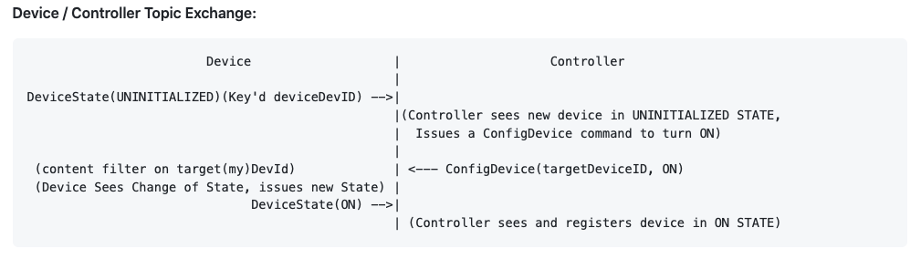
Topic Handshake
Two Topics - DeviceState & ConfigureDevice

Slide 5
Thank You!
Katie Lozeau, Paul Schmitt

